Slide 1
Data Warehousing and Data Mining
UNIT - 1 Department: CSE (AI) Semester: 6TH

Slide 2
This subject deals with handling large volumes of data and extracting useful information from it.
We study how data is stored efficiently and how meaningful patterns are discovered from that data.
It focuses on supporting analysis, reporting, and decision making.

Slide 3
Why Do We Need Data Warehousing and Data Mining?
Today, organizations generate huge amounts of data every day.
Traditional databases are not enough for analysis and long-term decisions.
We need special systems to store historical data and analyze it effectively.
This subject helps organizations make data-driven decisions.

Slide 4
What is Data Warehousing?
Data Warehousing is the process of collecting data from multiple sources and storing it in a central repository.
It stores large volumes of historical data in an organized manner.
The main purpose of a data warehouse is analysis, reporting, and decision support.
It is not used for daily transactions.

Slide 5
Data Warehousing – Real Life Example
Consider a college management system.
Daily activities like attendance, fee payment, and marks entry are stored in databases.
A data warehouse stores past data of many years.
It helps management analyze admission trends, pass percentages, and course performance.

Slide 6
What is Data Mining?
Data Mining is the process of discovering useful patterns, trends, and knowledge from large datasets.
It helps in prediction, classification, and pattern discovery.
Data mining answers questions like “what will happen next?”
It works mainly on data stored in data warehouses.

Slide 7
Data Mining – Real Life Example
Online shopping websites analyze customer purchase history.
They identify buying patterns and recommend products.
Healthcare systems use it to predict diseases based on patient data.

Slide 8
Database vs Data Warehouse
A database stores current and operational data. It supports daily transactions such as insert, update, and delete.
A data warehouse stores historical and summarized data. It supports analysis and decision making, not daily operations.

Slide 9
Characteristics of a Data Warehouse
A Data Warehouse has some special features that make it different from a normal database.
According to standard definition, a Data Warehouse is:
Subject-Oriented, Integrated, Time-Variant, and Non-Volatile

Slide 10
1️⃣ Subject-Oriented
Subject-oriented means that data is organized around major subjects of the organization, not around daily processes.
Subjects can be:
Students , Sales , Customers , Products , Employees
For example : In a college database:
Admission system stores admission data , Exam system stores marks , Fee system stores payment details
Each system works independently.
In a Data Warehouse, all data related to the Student is grouped together, including:
Admission details , Academic performance , Fee history
This allows management to analyze:
Student performance over years , Dropout rate , Course popularity

Slide 11
2️⃣ Integrated
Integrated means that data from different sources is combined into a consistent and unified format.
Different systems store data in different ways. A data warehouse removes these differences and stores data in a standard format.
For Example :
Student gender stored as:
“M / F” in one system
“Male / Female” in another
“1 / 0” in third system
Data Warehouse converts all of them into:
Male / Female
Integrated data means same meaning, same format, same structure.

Slide 12
3️⃣ Time-Variant
Time-variant means that a data warehouse stores historical data along with time information.
Databases mostly store current data. Data warehouses store data for many years, with date, month, or year information.
For Example :
College management wants to know:
Admission trend for last 5 years
Year-wise pass percentage
Database cannot answer this easily, but data warehouse can.
Data Warehouse remembers the past.

Slide 13
4️⃣ Non-Volatile
Non-volatile means that data once stored in a data warehouse is not frequently updated or deleted.
Operational databases allow insert, update, and delete operations regularly. Data warehouses mainly allow read-only operations for analysis.
For Example :
Fee record:
Database updates fee payment status.
Data Warehouse keeps old fee records permanently for financial analysis and audit.
Data Warehouse data is stable, not changing.

Slide 14
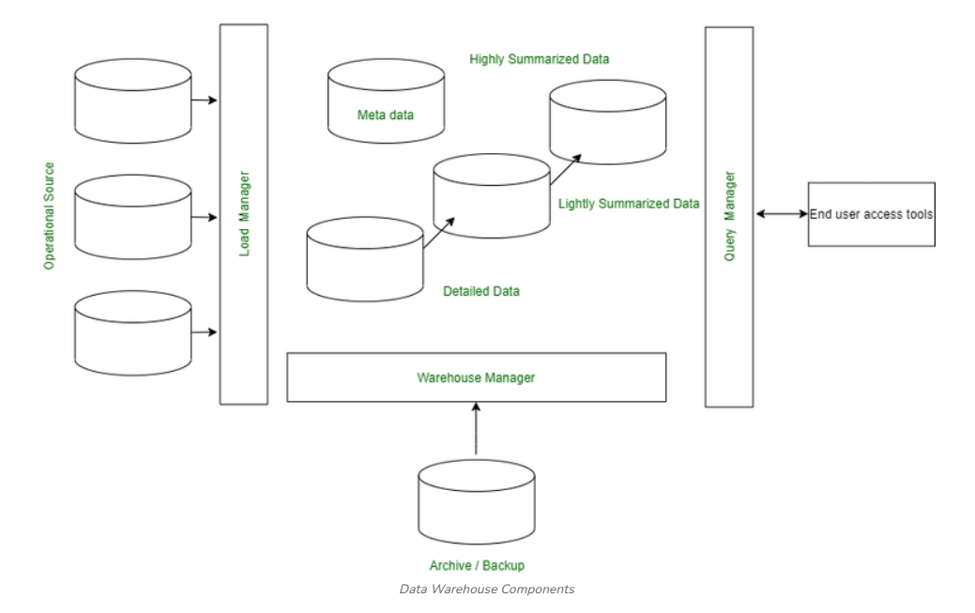
Components of a Data Warehouse
A Data Warehouse is a complete system made up of several components that work together to collect, store, process, and analyze data for decision making.

Slide 15
What is a Data Mart?
A Data Mart is a small and specialized part of a Data Warehouse
It is designed to serve a specific department or business unit
Focuses on a single subject area like:
Sales
Marketing
Finance
Human Resources
Data Warehouse vs Data Mart
Data Warehouse → Whole organization
Data Mart → One department or function

Slide 16
Key Characteristics
Subject-Oriented : Focuses on one business area (e.g., Sales, HR)
Smaller in Scope : Contains less data than a full data warehouse
Faster to Implement
Easier and quicker to build
Suitable for quick decision-making
Independent or Dependent : Can work alone or depend on a data warehouse
ETL Process
Uses ETL (Extract, Transform, Load)
ETL is simpler due to limited scope

Slide 17
Types of Data Marts
1. Dependent Data Mart
Built from an existing Data Warehouse
Ensures data consistency
Most commonly used
2. Independent Data Mart
Built directly from operational systems
Does not depend on a data warehouse
Faster but less consistent
3. Hybrid Data Mart
Combines data from:
Data Warehouse
Operational systems
External sources
Used for advanced and flexible analysis

Slide 18
What is Meta Data in Data Warehousing?
Metadata in data warehousing is data that describes other data. It provides information about the structure, meaning, origin, and usage of data stored in a data warehouse. Instead of containing actual business data, metadata acts as a guidebook that helps users and systems understand how data is organized and how it should be used.
For example: if a customer's purchase amount is the data, then the information about when the purchase was made, the data type, and the source system is its metadata.
Note: If data is the content, metadata is the documentation that explains what that content represents.

Slide 19
Examples of Metadata
File metadata: This includes information about a file, such as its name, size, type, and creation date.
Image metadata: This includes information about an image, such as its resolution, color depth, and camera settings.
Music metadata: This includes information about a piece of music, such as its title, artist, album, and genre.
Video metadata: This includes information about a video, such as its length, resolution, and frame rate.
Document metadata: This includes information about a document, such as its author, title, and creation date.
Database metadata: This includes information about a database, such as its structure, tables, and fields.
Web metadata: This includes information about a web page, such as its title, keywords, and description.

Slide 20
Types of Metadata in Data Warehousing
Metadata in a data warehouse is commonly divided into three main categories:
1. Business Metadata
Business metadata describes data in business-friendly terms so that non-technical users can understand it easily.
2. Technical Metadata
Technical metadata focuses on the physical and structural aspects of data.
3. Operational Metadata
Operational metadata tracks process-related information about how data moves and changes.

Slide 21
Three-Tier Architecture of Data Warehouse
Data warehousing helps businesses make informed decisions using large datasets. The Three-Tier Architecture is widely used for its clear structure, dividing data processing into three layers for efficient access and management.
Bottom Tier (Data Sources and Data Storage)
Middle Tier (OLAP Engine)
Top Tier (Front-End Tools)

Slide 22
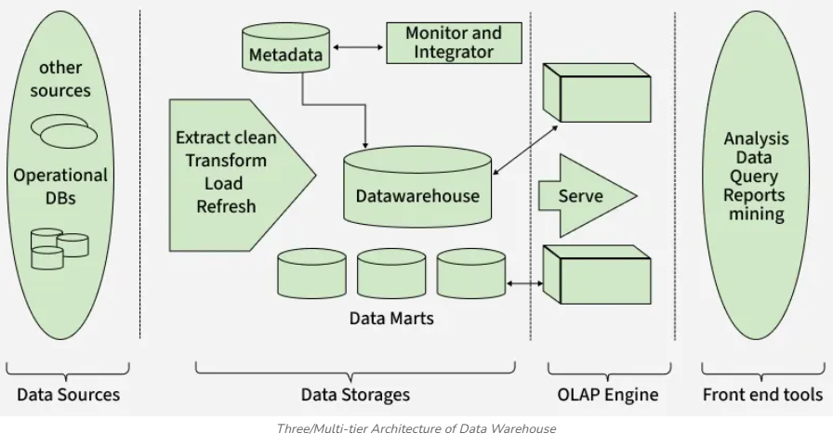

Slide 23
Problem in Traditional Systems
Data stored in multiple departmental databases
Different formats, structures, and standards
Direct access causes performance issues
Manual data collection is slow and error-prone
Difficult to generate integrated reports
Need of Data Gateway
Centralized and controlled data access
Reduce load on operational databases
Ensure data consistency and security
Support efficient Data Warehouse reporting

Slide 24
What is a Data Gateway?
A software-based middleware layer
Acts as a bridge between source systems and ETL/Data Warehouse
Provides secure, standardized, and controlled data access
How Data Gateway Works
Connects to multiple source databases
Filters and validates required data
Applies access and security rules
Transfers data securely to ETL/Data Warehouse

Slide 25
University Example
Departments: Admissions, Exams, Finance, Library
Data Gateway collects student data from all departments
ETL processes the data and loads it into Data Warehouse
Management generates combined student reports
Benefits of Data Gateway
Improved data security
Faster and accurate reporting
Reduced system load
Better decision-making
Scalable and flexible architecture

Slide 26
What is Database Synchronization?
Database synchronization is the process of keeping two or more databases consistent by ensuring that any update in one database is replicated or reflected in other related databases or the Data Warehouse.
Key Points:
Ensures all systems reflect the same information.
Can be real-time (instant updates) or batch-based (periodic updates).
Critical in Data Warehouse environments, where data comes from multiple heterogeneous sources.

Slide 27
Interoperability of Data and Applications
Interoperability means the ability of different systems, databases, applications, or software to work together, share data, and use that data correctly and meaningfully, even if they are built using different technologies.

Slide 28
Why Interoperability is Needed (Problem First)
In real organizations (like universities, hospitals, banks):
Different departments use different software
Databases may be:
MySQL, Oracle, SQL Server
Different data formats (CSV, JSON, XML)
Applications are developed by different vendors
Problems without Interoperability
Data cannot be shared easily
Same data entered multiple times
Reports become inconsistent
Manual data conversion required
Decision-making becomes slow and unreliable

Slide 29
Interoperability in Data Warehouse Context
In a Data Warehouse environment:
Data comes from multiple heterogeneous systems
These systems must:
Exchange data
Understand data meaning
Use common standards
👉 Interoperability ensures:
Smooth data integration
Consistent reporting
Unified analytics

Slide 37
Course Roadmap & Learning Outcomes
We will first study Data Warehousing concepts and architecture.
Then we will learn Data Mining techniques and algorithms.
By the end of the course, students will understand how data supports intelligent decisions.
This subject is important for careers in data science, analytics, and AI.

